Slide 1
C/C++ Program Design
CS205
Prof. Shiqi Yu (于仕琪)
yusq@sustech.edu.cn
http://faculty.sustech.edu.cn/yusq/

Slide 2
CNN for Image Classification
For Project 5

Slide 3
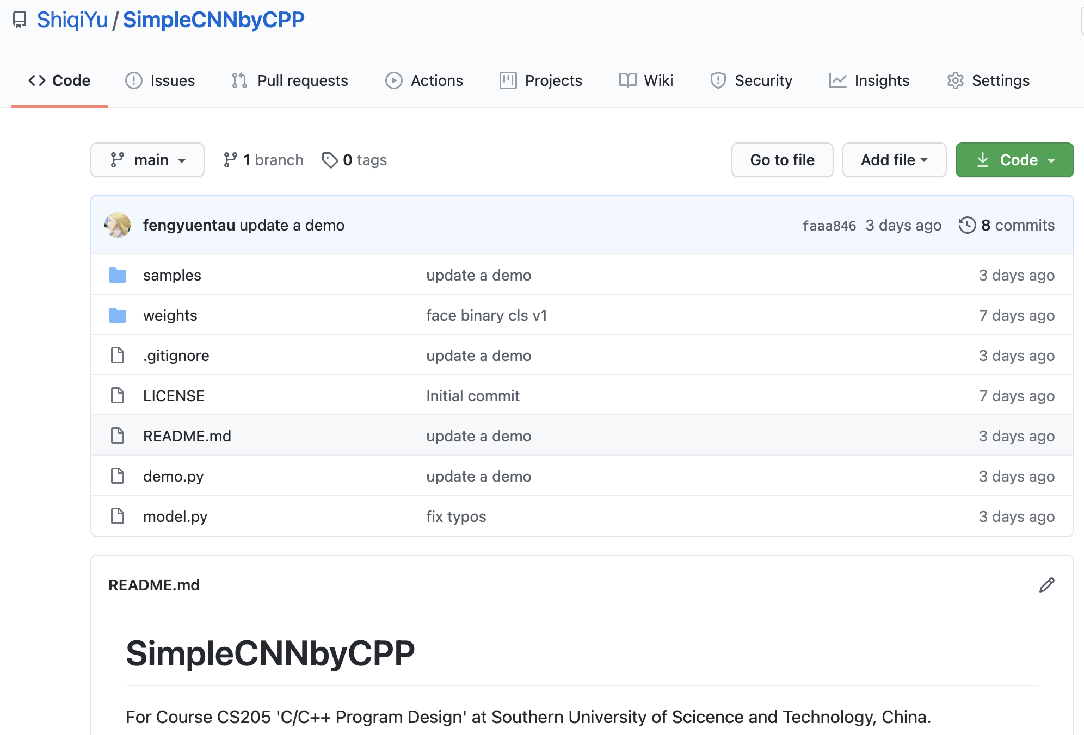


Pre-trained model
https://github.com/ShiqiYu/SimpleCNNbyCPP
CNN
0.02
0.98
CNN
0.95
0.05

Slide 4
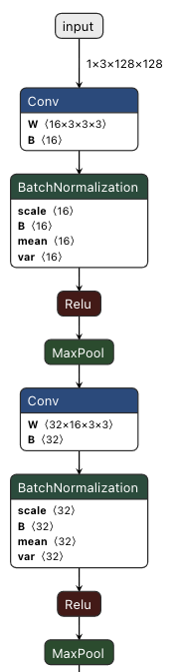
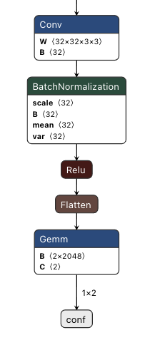
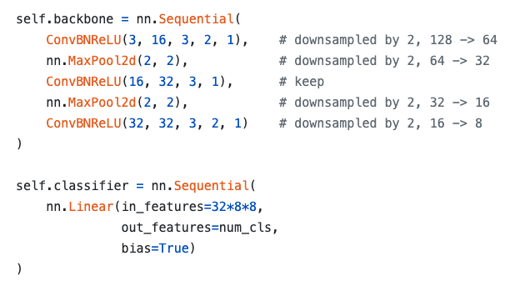
Model
3 Convolutional layers (Conv+BN+ReLU)
2 MaxPool
1 Full connected layer

Slide 5
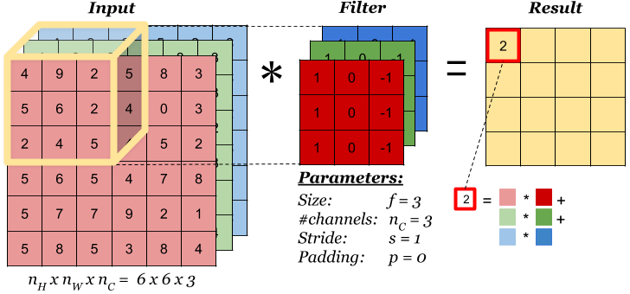
conv
Multiple filters (kernels) can create multiple output channels
https://www.zybuluo.com/hongchenzimo/note/1086311

Slide 6

conv
https://towardsdatascience.com/a-comprehensive-guide-to-convolutional-neural-networks-the-eli5-way-3bd2b1164a53

Slide 7

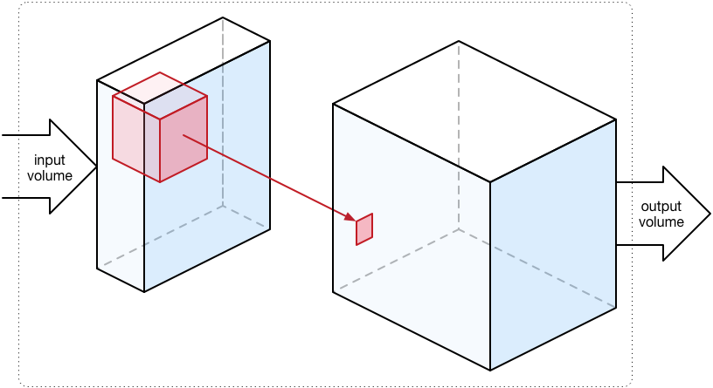
conv
A convolutional kernel create a channel in the output data.
https://towardsdatascience.com/a-comprehensive-guide-to-convolutional-neural-networks-the-eli5-way-3bd2b1164a53

Slide 8
Batch normalization
The BN layers have been merged into conv layers

Slide 9
ReLU: Rectified Linear Unit
if (x < 0)
x = 0;

Slide 10

max pooling
For each channel
If the input is C x H x W, the output will be C x H/2 x W/2

Slide 11
Flatten
The data blob is flatted into a 2048-length vector from 32x8x8

Slide 12
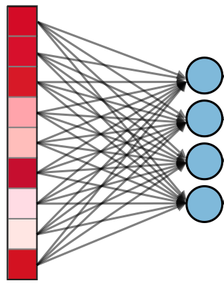
FC: Fully-Connected Layer
If the input is L and the output is N (2 in the model, 4 in left figure), the size of weights is NxL (2x2048 in the model)
output_{2x1} = weight_{2x2048} *input_{2048x1}+bias_{2x1}

Slide 13
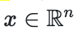
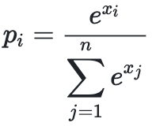
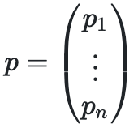
Softmax
To output the confidence vector (n=2 in the model)
for

Slide 14
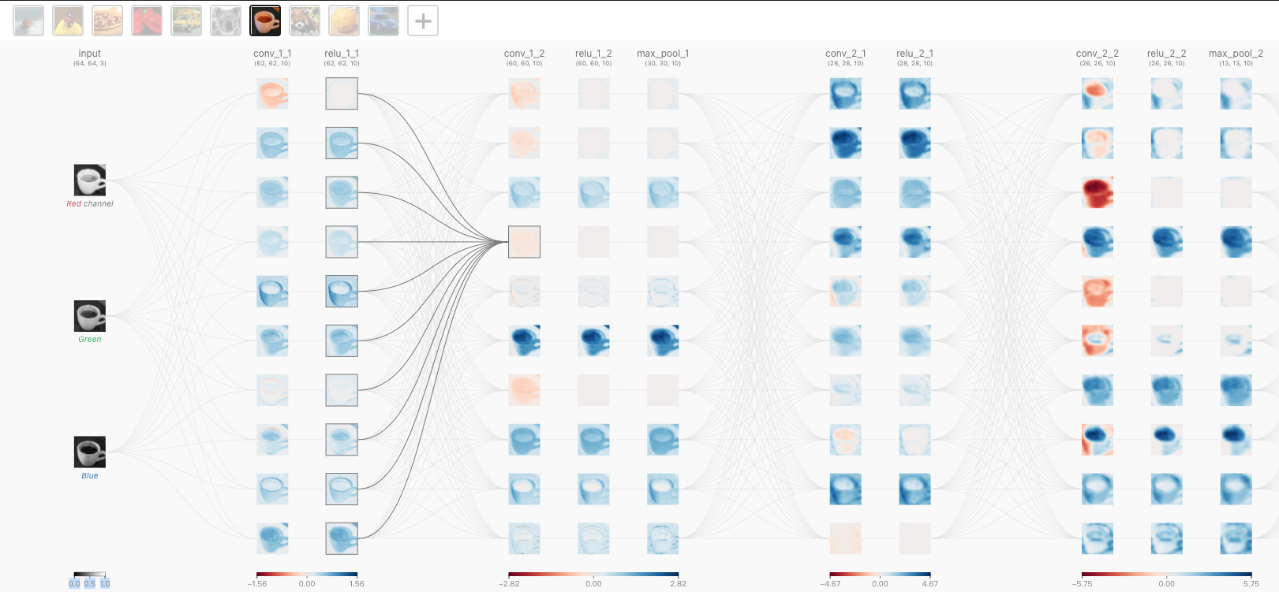
CNN Explainer
https://poloclub.github.io/cnn-explainer/

Slide 15
Class Templates

Slide 16
Review: Function Templates
A function template is not a type, or a function, or any other entity.
No code is generated from a source file that contains only template definitions.
The template arguments must be determined, then the compiler can generate an actual function
"Function templates" vs "template functions".
template<typename T>
T sum(T x, T y)
{
cout << "The input type is " << typeid(T).name() << endl;
return x + y;
}
// instantiates sum<double>(double, double)
template double sum<double>(double, double);
// instantiates sum<char>(char, char), template argument deduced
template char sum<>(char, char);
// instantiates sum<int>(int, int), template argument deduced
template int sum(int, int);

Slide 17
Review: Function Templates
Implicit instantiation occurs when a function template is not explicitly instantiated.
template<typename T>
T product(T x, T y)
{
cout << "The input type is " << typeid(T).name() << endl;
return x * y;
}
// Implicitly instantiates product<int>(int, int)
cout << "product = " << product<int>(2.2f, 3.0f) << endl;
// Implicitly instantiates product<float>(float, float)
cout << "product = " << product(2.2f, 3.0f) << endl;

Slide 18
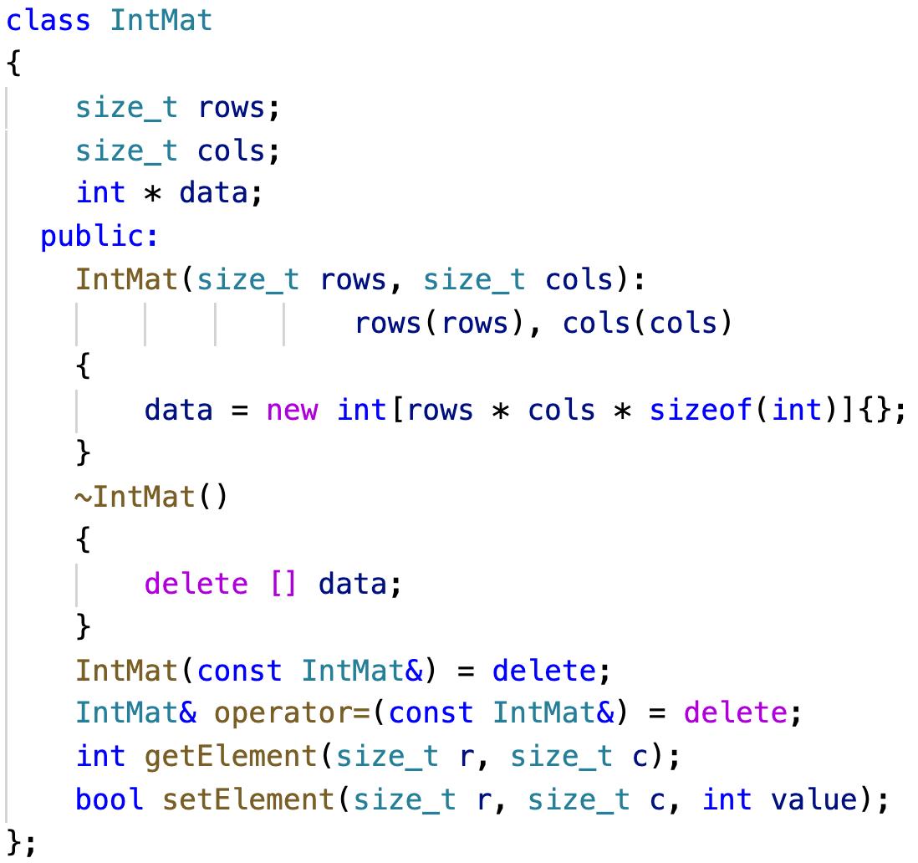
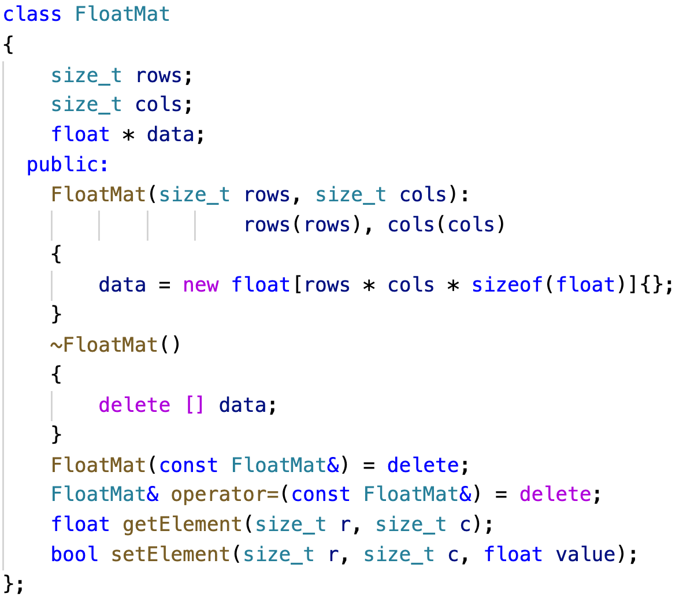
Different Classes for Different Type Matrices
Matrix with int elements, Matrix with float elements
matclass.cpp

Slide 19
Class Templates
A class template defines a family of classes.
Class template instantiation.
// Explicitly instantiate
template class Mat<int>;
class Mat
{
size_t rows;
size_t cols;
T * data;
public:
Mat(size_t rows, size_t cols): rows(rows), cols(cols)
{
data = new T[rows * cols * sizeof(T)]{};
}
~Mat()
{
delete [] data;
}
T getElement(size_t r, size_t c);
bool setElement(size_t r, size_t c, T value);
};
mattemplate.cpp

Slide 20
Template Non-Type Parameters

Slide 21
Non-Type Parameters
vector<int> vec1;
vector<int, 16> vec2;
To declare a template
The parameters can be
type template parameters
template template parameters
non-type template parameters
integral types
floating-point type
pointer types
lvalue reference types
...
template < parameter-list > declaration

Slide 22
Non-Type Parameters
If we want to create a static matrix (no dynamic memory allocation inside)
template<typename T, size_t rows, size_t cols>
class Mat
{
T data[rows][cols];
public:
Mat(){}
Mat(const Mat&) = delete;
Mat& operator=(const Mat&) = delete;
T getElement(size_t r, size_t c);
bool setElement(size_t r, size_t c, T value);
};
Mat<int> vec1(3, 3);
Mat<int, 3, 3> vec2;
nontypeparam.cpp

Slide 23
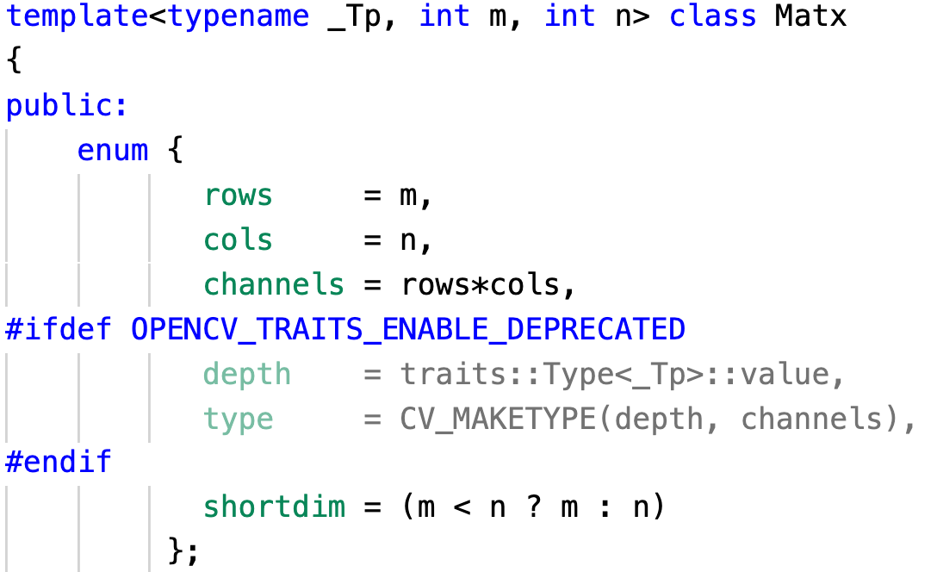
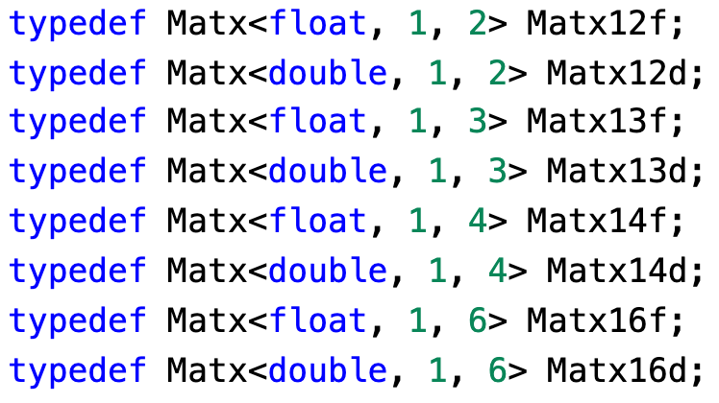
Template in OpenCV

Slide 24
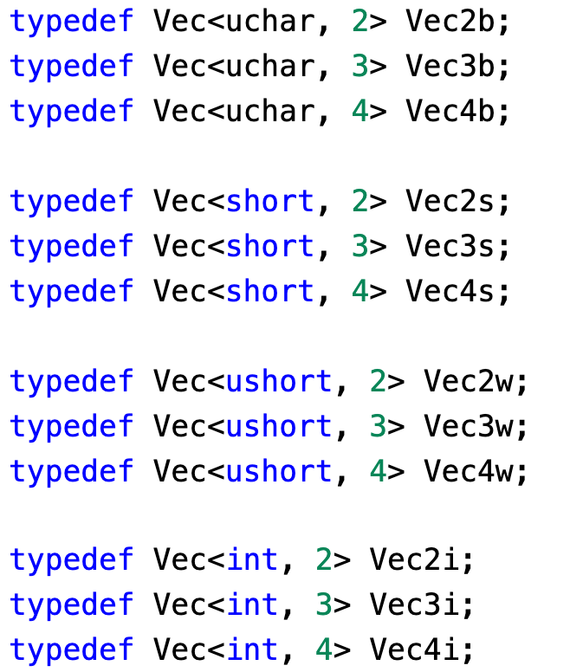
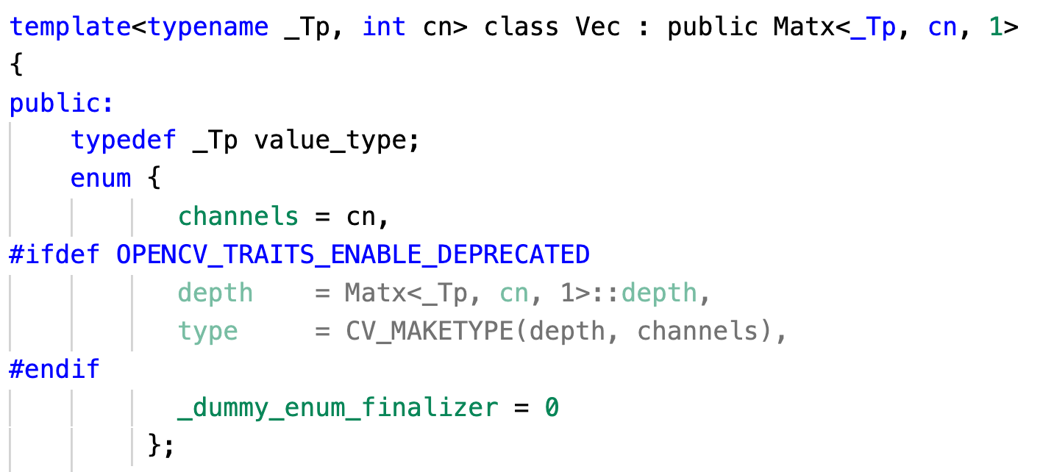
Template in OpenCV

Slide 25
Class Template Specialization

Slide 26
Class template specialization
The class template can be for most types
But we want to save memory for type bool (1 byte or 1 bit).
template<typename T>
class MyVector
{
size_t length;
T * data;
public:
MyVector(size_t length): length(length)
{ data = new T[length * sizeof(T)]{}; }
~MyVector()
{ delete [] data; }
MyVector(const MyVector&) = delete;
MyVector& operator=(const MyVector&) = delete;
T getElement(size_t index);
bool setElement(size_t index, T value);
};

Slide 27
Class template specialization
template<>
class MyVector<bool>
{
size_t length;
unsigned char * data;
public:
MyVector(size_t length): length(length)
{
int num_bytes = (length - 1) / 8 + 1;
data = new unsigned char[num_bytes]{};
}
~MyVector()
{
delete [] data;
}
MyVector(const MyVector&) = delete;
MyVector& operator=(const MyVector&) = delete;
bool getElement(size_t index);
bool setElement(size_t index, bool value);
};
Specialize MyVector for bool
specialization.cpp

Slide 28
std classes

Slide 29
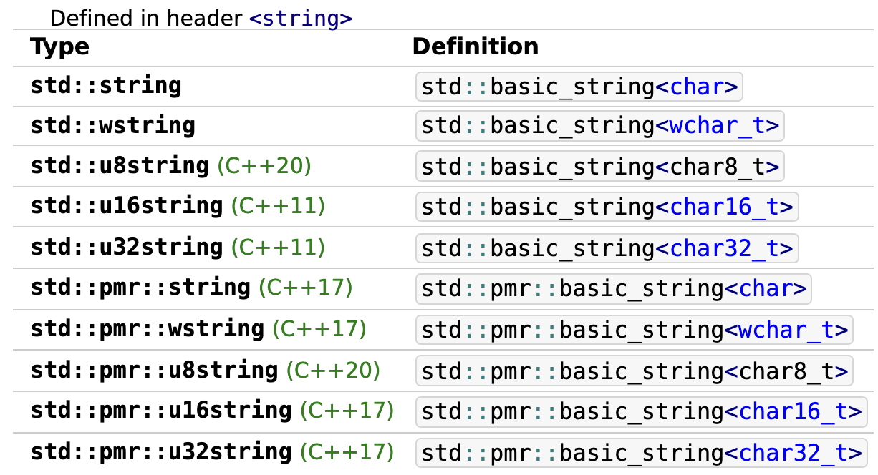
std::basic_string
Store and manipulate sequences of char-like objects.

Slide 30
std::array
a container that encapsulates fixed size arrays.
template<
class T,
std::size_t N
> struct array;
std::array<int, 3> a2 = {1, 2, 3};
*Keyword: typename/class, class/struct

Slide 31
Some other templates
template< class T, class Allocator = std::allocator<T>
> class list;
template< class Key, class Compare = std::less<Key>, class Allocator = std::allocator<Key>
> class set;
template< class T, class Allocator = std::allocator<T>
> class vector;
template< class Key, class T, class Compare = std::less<Key>, class Allocator = std::allocator<std::pair<const Key, T> >
> class map;
template< class T, class Container = std::deque<T>
> class stack;

